Slide 1


Patanjali
Patanjali Ayurved is an Indian Multinational conglomerate holding company.
Patanjali “S” headquater is in Haridwar Uttarakhand.
It was founded by Baba Ramdev&Balakrishna.
It manfactures Ayuurvedic medicines,Cosmetics,etc.
Its” revenue is 30,000 Crores(US$4.02 billion & has total assets of 4,350 crores.

Slide 2
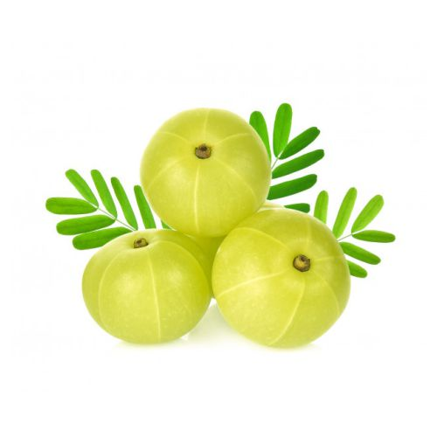
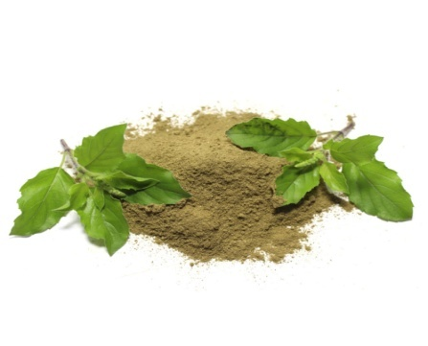
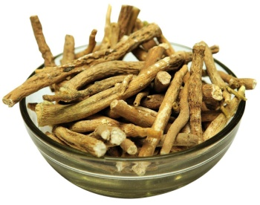
History:-
Ramdev and Balakrishna started Patanjali as a small pharmacy in the year 1997.
The name was taken from Patanjali yogi maharshi the pioneer of Yoga.
Patanjali contain various Ayurvedic herbs which benfits health and are commonly used in traditional ayurvedic medicines.
The products which are used as ingridents are Amla,Ashwaganda,Tulasi, etc.

Slide 3
Market:-
The current market valuation of Patanjali is around 300 Crores of Indian Rupees.
The company has 2,00,000 employees.
The company “S” revenue according to $ 4.02 billion.
The company owns $ 590 million of net income.
The company earns 40,000 rupees per capita income.

Slide 4


Production:-
Patanjali Food and herbal in May 2016 the company had 4,700 retail outlets.
Patanjali sells its” product in 18 states and proposed factories in 6 states.
There are about 23 factories across India.
The share price of natural toothpaste is abuot 15%.
Cow Ghee is the highest selling product of Patanjali & earnsa revenue of 1,467 crores.

Slide 5
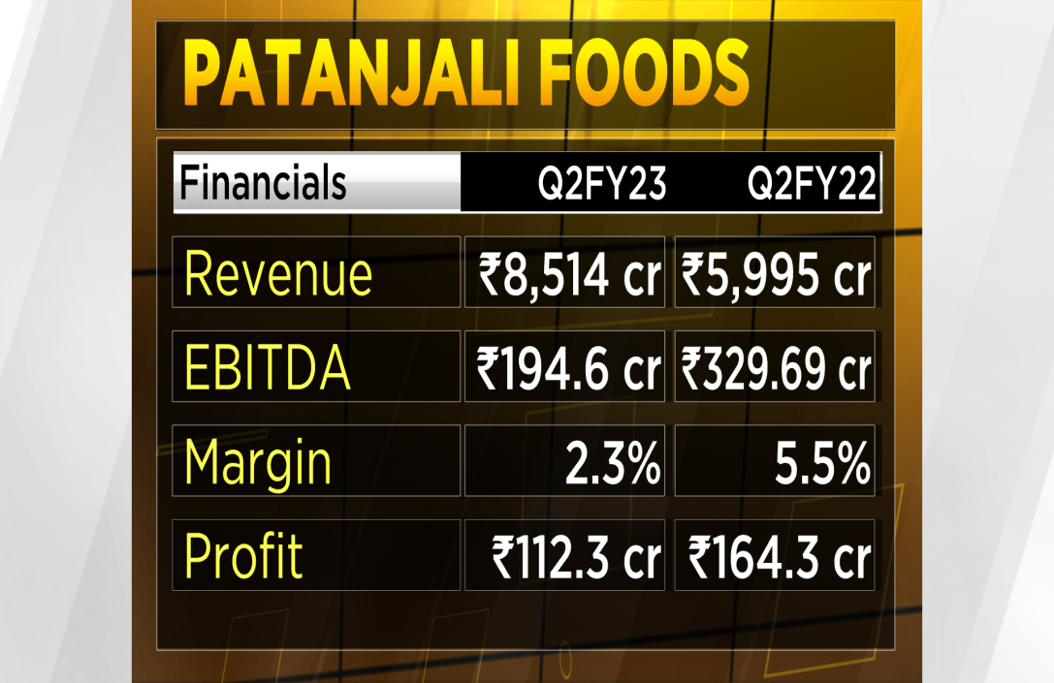
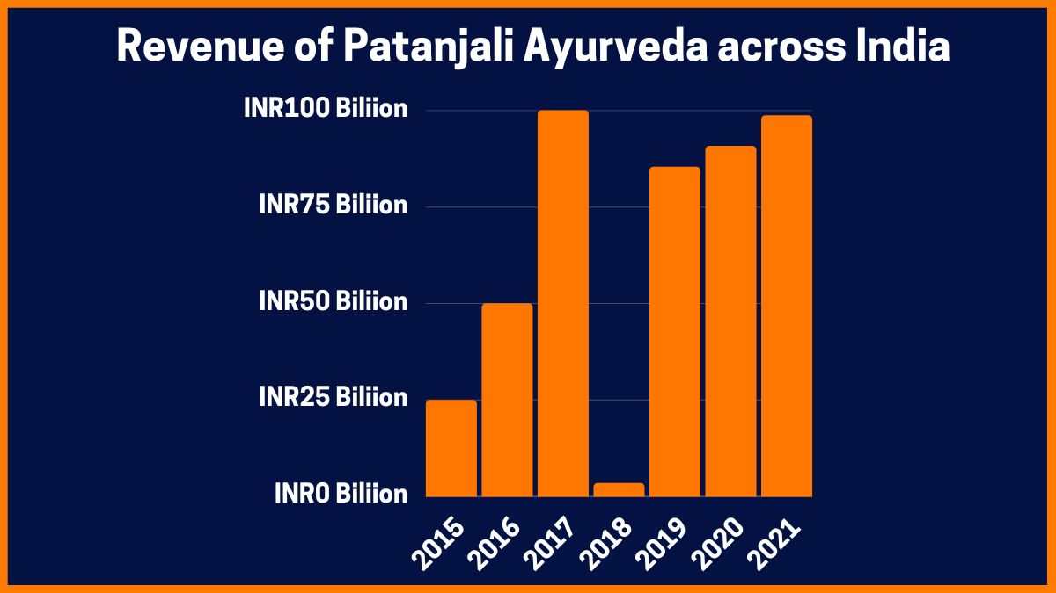
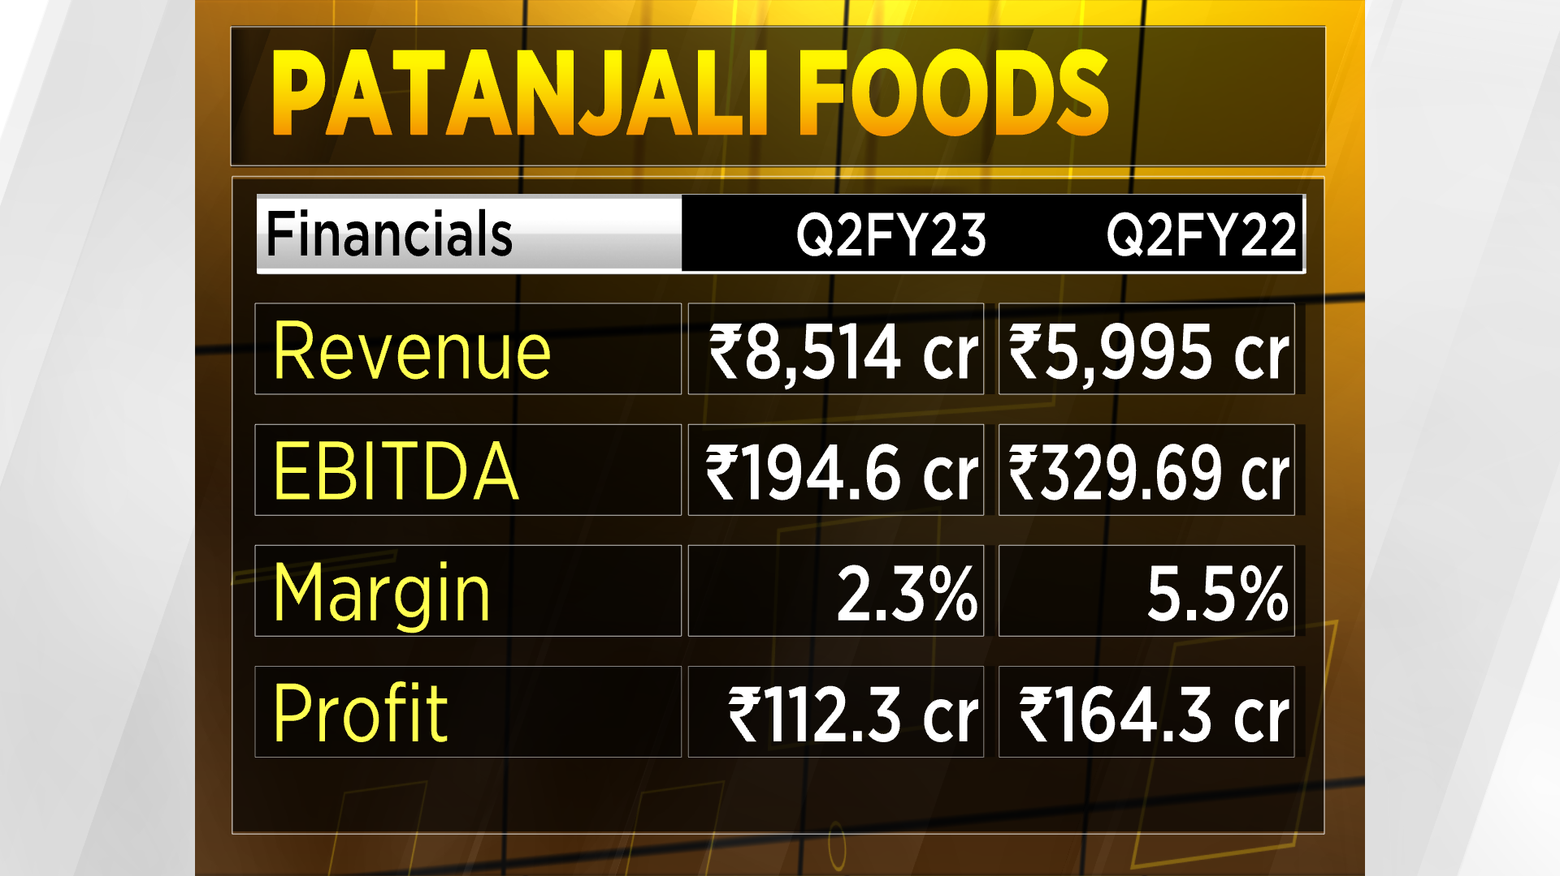
The company had the target revenue of R.S10,000 crores (US$1.3Billion).
In the year 2016-17 after the sales increased by 150%.
In previous financial year it collecterd 5000 crores.

Slide 6
Design:-
The symbol of OM-Hindu religion and indian tradition forms the essence of Patanjali logo.
A picture of a yogi reprasenting Baba Ramdev-the brand face that help people to trust the brand.
A sapling indicate herbal & ayurvedic products.
The stroke of green,white&saffron colour depicting Indian flag Swadeshi being Indian.

Slide 7
Thank You

